Slide 1
AdaBoost Regression

Slide 2
AdaBoost Regression Algorithm
The AdaBoost Regressor is an ensemble machine learning algorithm
That sequentially builds multiple "weak learners“
It evaluates errors from previous models
Forcing the next learner to focus on difficult-to-predict values

Slide 3
PROCESS
Initialize Weights: Every data point in the training set starts with an equal weight.
Train & Predict: A weak learner (a Decision Tree with max_depth=1) makes predictions.
Evaluate Error: Calculate the error for each point. Points with higher errors get increased importance/weight.
Sequential Training: The next model learns specifically from the mistakes of the previous ones

Slide 4
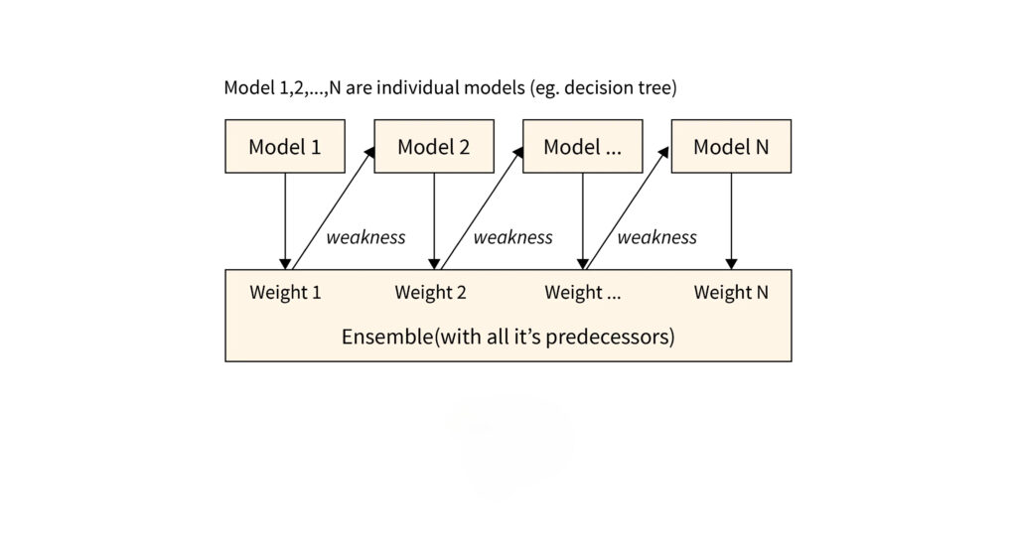

Slide 5
Thank You!

